Slide 1
Single Working Taxpayer
Tom Andrews

Slide 2
Single Working Taxpayer
This lesson will focus on a tax return for a typical single employed taxpayer
The following tax topics will be discussed:
  Who Must/Should File a Tax Return
  Single Filing Status
  Income: Wages, Unemployment, Interest, and NJ Income Tax Refund
  Adjustments: IRA Contributions/Deductions and Student Loan Interest
  Standard Deduction
  Credits: Retirement Savings Credit
  Federal Health Insurance
  NJ Entries

Slide 3
Basic Information
Tom Andrews

Slide 4
Scenario Step 0
Basic Information

Slide 5
Who Must File a Tax Return?
Federal and State filing requirements are different
  A taxpayer may be required to file a Federal return but not a NJ State return
  A taxpayer may be required to file a NJ State return but not a Federal return
Even if a taxpayer is not required to file a tax return, there are cases where the return should be filed anyway
  E.g. – To get back taxes withheld from paycheck
IRS guidelines suggest all returns be filed, even if not required. This is to help prevent fraud

Slide 6
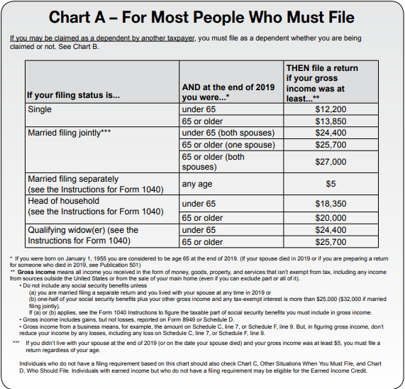
Federal Filing Income Thresholds for Most People – Pub 4012 Page A-1
Filing thresholds are
based on filing status,
age, and gross income

Slide 7
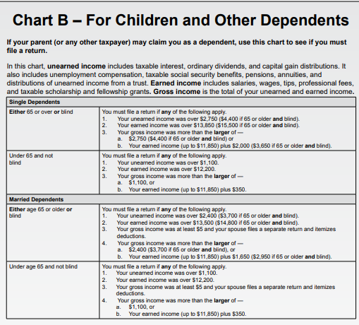
Federal Filing Income Thresholds for Children and Other Dependents – Pub 4012 Page A-2
If you can be claimed as a dependent by another taxpayer, filing thresholds are based on marital status, age, blindness, and income (earned, unearned, and gross income)

Slide 8
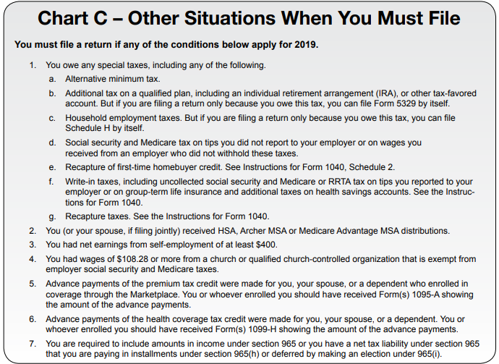
Other Situations When You Must File
– Pub 4012 Page A-3

Slide 9
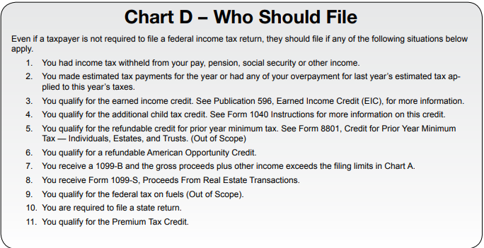
Who Should File, Even If Not Required
– Pub 4012 Page A-3

Slide 10
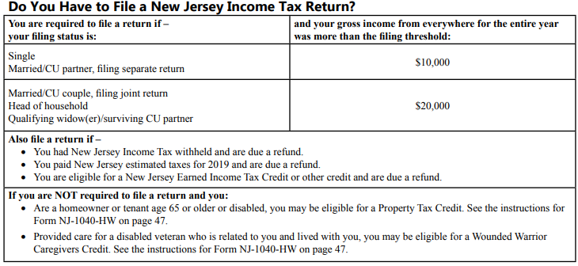
NJ Filing Requirements – NJ 1040 Instructions
NJ filing thresholds
are based on
filing status and
gross income
Other reasons you should file NJ

Slide 11
Filing Status
Three main criteria used to determine taxpayer filing status:
  Marital status on last day of tax year
    Federal definition of “married”
      Legal marriage under laws of any state or country
      Does not include civil unions or registered domestic partners
  Persons living in the home (may or may not be dependents) or supported by taxpayer
  Who pays to keep up the home
Notes:
11

Slide 12
Filing Status Importance
Many tax items affected by filing status
  Necessity to file a return
    (Pub 4012 Page A-1 Chart A)
  Standard deduction
    (Pub 4012 Page F-1 Exhibit 1)
  Tax rate bracket
  Eligibility for certain credit
  (E.g.-Earned Income Credit on Pub 4012 Page I-3, and other credits)
Notes:
12

Slide 13
Choice of Five Filing Statuses
Federal & State Similar With Some Differences
Federal Filing Status | State Filing Status
Single | Single
Married Filing Joint (MFJ) * | Married/Civil Union Filing Jointly *
Married Filing Separate (MFS)* | Married/Civil Union Filing Separate *
Head Of Household (HOH) | Head Of Household (HOH)
Qualifying Widow/er (QW) | Qualifying Widow/er /Surviving Civil Union Partner
* Married same-sex couples treated as Married filing status
Civil union filing statuses out of scope

Slide 14
To Determine Filing Status, Do an Analysis Of Taxpayer’s Living Situation
Use information from Intake/Interview Sheet, Part II
  Marital status
  Taxpayer-completed info on people who lived with them or whom they supported
  Answers to questions in shaded section that counselor completes based on interview
Determine:
  Marital status as of December 31 of the tax year
  People who were living in the home during the year
  People whom taxpayer supported
  Their relationship/dependency
  Who paid more than half the cost of keeping up the home
  Date of death if either/both spouse(s) deceased
Notes:
14

Slide 15
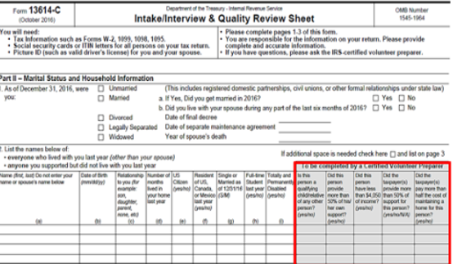
Intake/Interview Sheet – Part II
Marital status
Completed by
counselor based
on interview
Completed by
taxpayer

Slide 16
Filing Status: Single
Not married as of December 31
Married, but legally separated
  NJ does not recognize legal separation, and IRS follows state rules. Therefore, separated in NJ cannot file single
There may be a more advantageous filing status if the taxpayer has a dependent or another qualifying person (covered in later lessons)

Slide 17
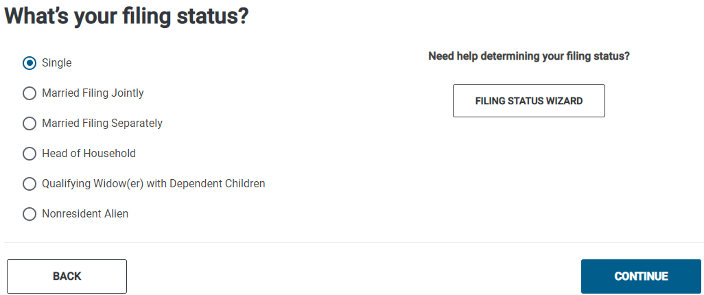
TSO – Entering Filing Status
Basic Information>Filing Status
Filing status
Filing status

Slide 18
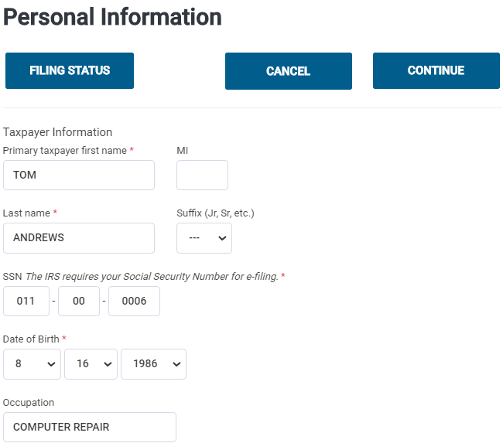
TSO – Entering Personal Information for Taxpayer
Basic Information>Personal Information
Name as shown on SS card
TSO transfers from SS # used to start return
Date of birth
Occupation

Slide 19
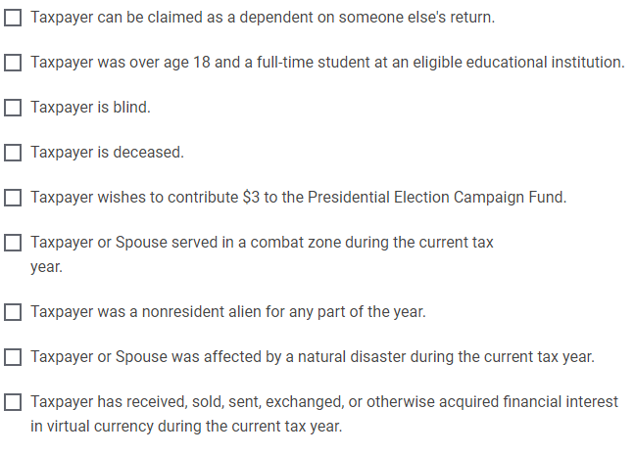
TSO – Entering Personal Information for Taxpayer/Spouse
cont’d
Check any boxes that apply

Slide 20
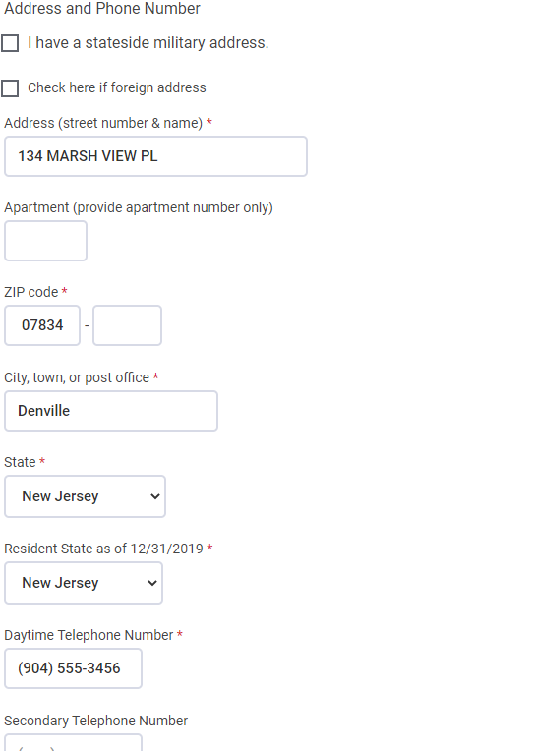
TSO – Entering Personal Information for Taxpayer/Spouse
cont’d
Current address where taxpayer
can be reached
Enter zip code;
TSO populates city and state;
Correct if needed
State lived in as of 12/31;
Determines which state return is needed
Not used by IRS; for us to reach
taxpayer if needed

Slide 21
TSO – TaxSlayer Automatically Starts NJ Return
TSO populates Resident State as of 12/31 based on state of current address
  If taxpayer lived in a different state on 12/31, correct as needed
  TSO then automatically starts the appropriate state return
  Makes NJ refund monitor available as soon as first income entry is made
To start the NJ return, must answer some basic questions:
  NJ property tax deduction or credit
    Just answer NO for now; we will deal with this in State section
  Taxpayer NJ health insurance
    Answer YES for now; we will deal with this in State section
  Just hit Continue on the next screen; will answer these questions later in State section

Slide 22
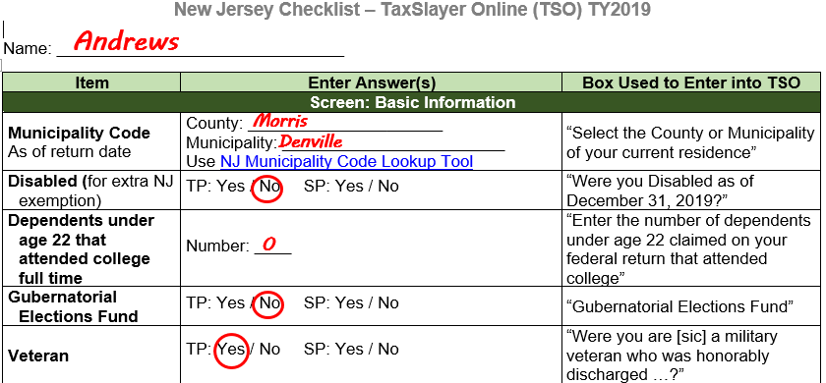
Enter Additional Personal Info on NJ Checklist

Slide 23
Dependents
Does Tom Andrews have any dependents?
  On Intake sheet, Scott Davis is listed as someone who lives with Tom. Probe with client
    Scott is a roommate – lives in a separate room in house and shares household expenses
    Scott is a full-time employee at a local business; he supports himself and files his own tax return
  Scott is not Tom Andrews’ dependent
    Answer NO to TSO question about dependents

Slide 24
TSO - Student Activity
Basic Information>Filing Status and Personal Information
Pause the slide show
Enter the taxpayer Basic Information into TSO (Step 0)
Start the NJ return by answering NO to the Property Tax Deduction/Credit question and YES to the Health Insurance question. Then click on Continue on next screen (Step 0)
Make sure all answers to the NJ Basic Information section questions on the NJ Checklist were filled in

Slide 25
Income
Tom Andrews

Slide 26
Income
Taxable vs. Non-Taxable
  Pub 4012 Page D-1 shows lists of taxable and non-taxable income
  Rules for what is taxable vs. non-taxable on NJ return may be different from Federal
    Will discuss differences in later lessons
Earned vs. Not Earned
  Pub 4012 Page I-1 shows lists of earned and unearned income
  Important for eligibility for certain credits

Slide 27
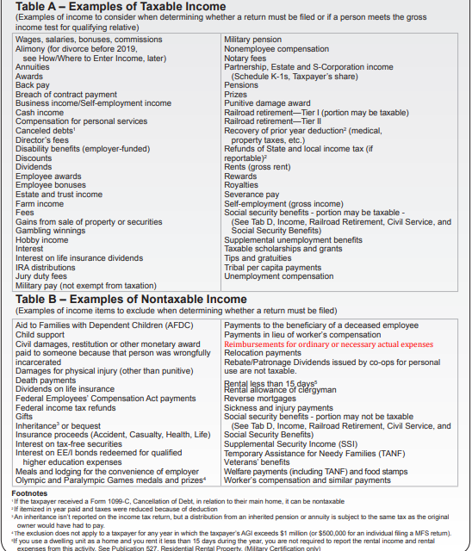
Taxable vs. Non-Taxable Income – Pub 4012 Page D-1

Slide 28
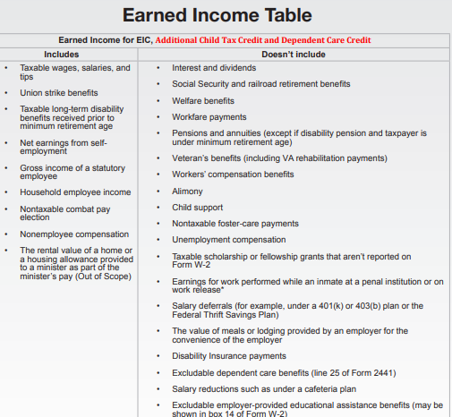
Earned vs. Unearned Income – Pub 4012 Page I-1

Slide 29

Scenario Step 1
W-2 Marc Tecktronics

Slide 30
Employee Compensation
Employee compensation includes:
  Wages, salaries, tips, severance pay, bonuses, & commissions
  Also cash, goods & services, awards, & taxable benefits
Considered earned income
Reported on Form W-2
Reimbursement of expenses employee paid out of pocket is not included in W-2 wages

Slide 31
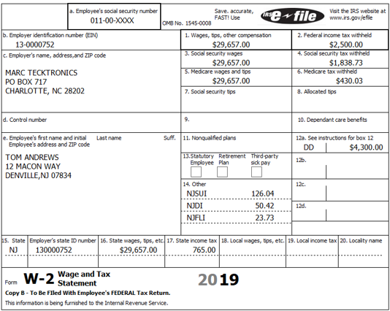
Form W-2
Enter every box exactly
as is shown on W-2
Verify current tax year

Slide 32
Gross Wages vs. Social Security Wages vs. Medicare Wages
For a lot of clients, Box 1 Wages, Box 3 Social Security Wages, and Box 5 Medicare Wages amounts are the same; however, they can be different
  Box 1 is total taxable wages or salary for federal income tax purposes
    Not necessarily the total amount earned during the year, since does not include pre-tax benefits such as 401k contributions
  Box 3 is total amount of your wages subject to Social Security tax
    The Social Security tax rate for 2019 is 6.2%
    The Social Security maximum taxable income for 2019 is $132,900
  Box 5 is the amount of wages subject to the Medicare Tax
    The Medicare tax rate for 2019 is 1.45%
    No maximum wage base for Medicare

Slide 33
Gross Wages vs. Social Security Wages vs. Medicare Wages
cont’d
TSO auto-populates Boxes 3, 4, 5, 6 based on entry in Box 1
  Change Boxes 3 and 5, if necessary, to match printed W-2 if not the same as Box 1
  TSO will recalculate Boxes 4 and 6
    Verify that calculated amount matches printed W-2; if not, correct as necessary match printed amount

Slide 34
W-2 Box 12 Codes
Codes we see most often (26 possible codes):
  D – Elective deferrals to a section 401(k) (Codes E through H are elective deferrals to other qualified plans)
  DD – Cost of employer-sponsored health coverage (information only; does not impact taxes but must be entered into TSO)
Pub 4012 Page D-6 shows other codes
  Also shown on back of W-2
Box 12 codes that are out of scope
  Code R – Archer Medical Savings Acct (MSA)
  Code T – adoption benefits
  Code Q – nontaxable combat pay (unless certified for Military)

Slide 35
What Else is Out of Scope on W-2?
cont’d
Ministers/church workers (special tax rules)
Very high earned income that is subject to the additional Medicare tax
  MFJ: $250,000
  MFS: $125,000
  S, HoH or QW: $200,000

Slide 36
W-2 Box 14 Codes
Refer to NJ Special Handling document on TP4F Preparer page
NJ taxes withheld from income for unemployment, disability and family leave insurance
  May sometimes appear below Boxes 19 and 20, instead of in Box 14
  Deductible as an itemized deduction on Federal Schedule A Line 5
  TSO transfers amounts from W-2 to Schedule A automatically
State Unemployment Insurance
  UI/SUI - Unemployment Insurance/State Unemployment Insurance
  WF – Workforce Fund
  SWF – Supplemental Workforce Fund
  Choose NJ UI/HC/WD – NJ Unemployment Insurance from TSO W-2 Box 14 drop-down menu (combine together if listed separately)
  Maximum contribution amount can change each year; maximum for 2019 is $146.20

Slide 37
W-2 Box 14 Codes
cont’d
State Disability Insurance
  Choose NJ SDI - NJ Disability Insurance from TSO W-2 Box 14 drop-down menu
  Maximum contribution amount can change each year; maximum for 2019 is $58.48
Family Leave Insurance
  Choose NJ FLI from TSO W-2 Box 14 drop-down menu
  Maximum contribution amount can change each year; maximum for 2019 is $27.52

Slide 38
State Section of W-2 (Boxes 15-17)
Boxes 15 -17 contain information about your state wages and withholdings
  Box 15 – State where you earned wages and employer state ID #
  Box 16 – NJ taxable wages
  Box 17 – State taxes withheld
TSO auto-populates Box 16 based on the Federal amount in Box 1
  If Box 16 on the printed W-2 is different, correct as necessary

Slide 39
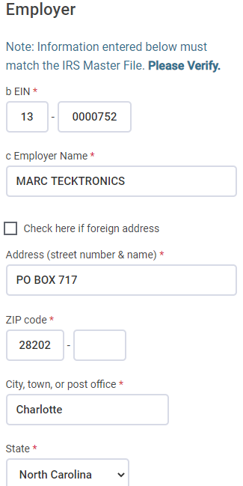
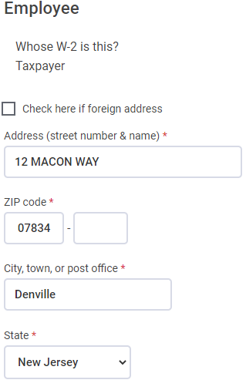
TSO - Entering W-2
Federal Section>Income>W-2
Employee
Information
Employer
Information
From entries in Basic Information;
Note that address
was changed to match printed W-2
Enter EIN; TSO may auto-
populate name and address;
verify and correct if needed

Slide 40
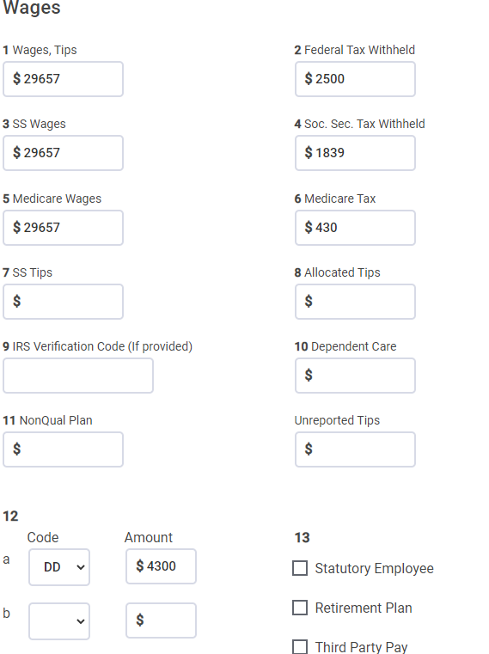
TSO - Entering W-2
cont’d
Enter
TSO auto-
populates; change if needed
Choose code
from drop-down
menu
C
Check any box checked on W-2

Slide 41
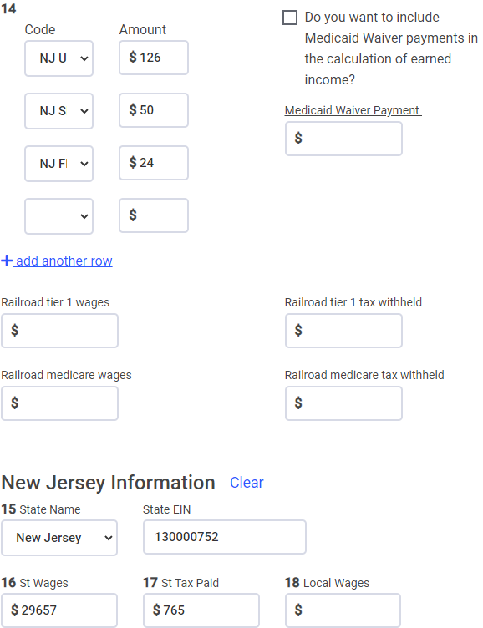
TSO - Entering W-2
cont’d
Choose codes
from drop-down
menus
TSO transfers
from Box 1;
change if needed
TSO may auto-populate; correct if needed
Enter if not auto-populated

Slide 42
TSO - Student Activity
Federal Section>Income>W-2
Pause the slide show
Enter the Marc Tecktronics W-2 into TSO (Step 1)
Check the Federal and NJ refund monitors

Slide 43
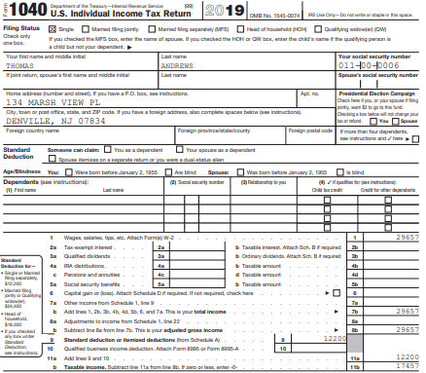
TSO - Wages on Federal 1040
Transferred from W-2
Box 1

Slide 44
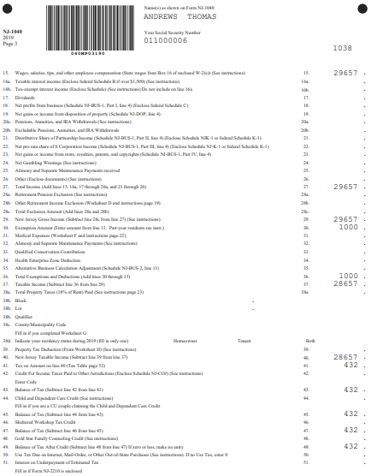
TSO - Wages on NJ 1040
Transferred from W-2
Box 16

Slide 45
Scenario Step 2
Unemployment Compensation

Slide 46
Unemployment Compensation
Unemployment income is considered unearned income
Unemployment income is taxable for Federal, but non-taxable for NJ
  Refer to NJ Special Handling document on TP4F Preparer page
  TSO automatically handles this; no need to enter anything on NJ Checklist
  Unemployment income from another state also nontaxable for NJ
Reported on 1099-G Statement for Certain Government Payments

Slide 47
Unemployment Compensation
1099-G not mailed to taxpayer; must look up info on NJ Dept. of Labor website
  Site is: http://lwd.state.nj.us/labor/ui/content/1099G.html OR
  Link from TP4F Preparer page: NJ Form 1099-G Inquiry (Unemployment)
  Taxpayer must have a user name, password & PIN to view/print 1099-G

Slide 48
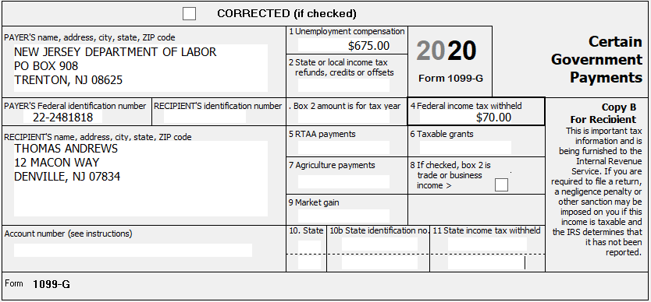
Unemployment – Form 1099-G
19
Out-of-Scope
Tom Andrews gave us unemployment info during interview; we confirm online
using link from TP4F Preparer page

Slide 49
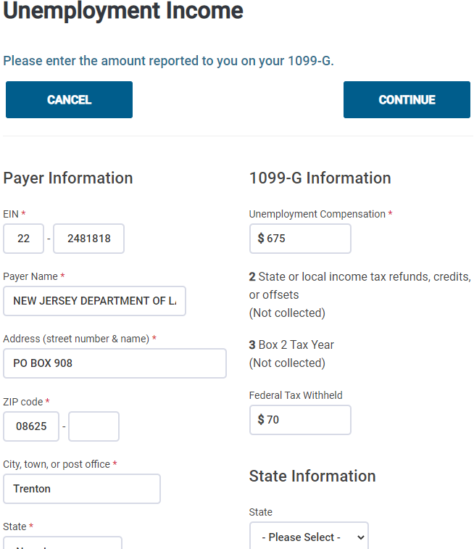
TSO – Entering Unemployment
Federal Section>Income>Form 1099-G Box 1
Enter EIN; TSO will auto-
populate name and
address if available;
verify and change if
needed
Unemployment income
Federal tax withheld

Slide 50
TSO - Student Activity
Federal Section>Income>Form 1099-G Box 1
Pause the slide show
Enter the Unemployment Compensation into TSO (Step 2)
Check the Federal and NJ refund monitors
  NJ refund monitor does not change because unemployment is not taxable for NJ

Slide 51
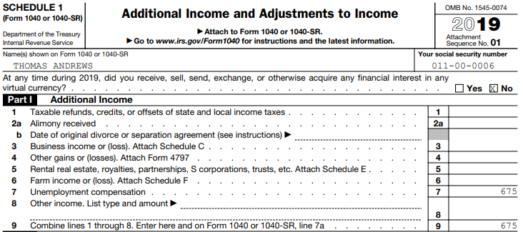
TSO – Unemployment on Schedule 1, Part 1
Transferred from
1099-G Box 1
Total of all Addi- tional Income

Slide 52
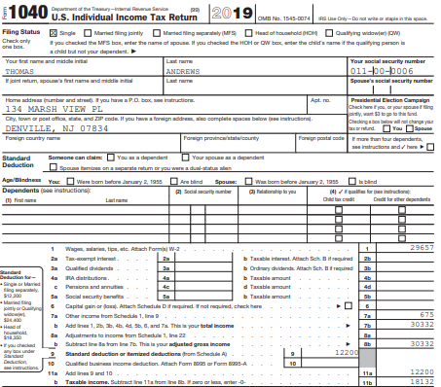
TSO – Unemployment on Federal 1040
Transferred from Sch 1,
Part I, total

Slide 53
Scenario Step 3
Interest – Nations Bank

Slide 54
Interest
Interest can be either taxable or non-taxable income, depending on source of interest
Interest is considered unearned income
Interest sources:
  Bank and credit union deposits
    Credit unions may call this “dividends” but it is entered as interest
  Bonds (corporate or government)
  Money loaned out

Slide 55
Interest – Tax Forms
Interest may be reported by payer on any of these forms, as appropriate
  Form 1099-INT
  Form 1099-OID (Original Issue Discount)
  Brokerage Statement
  Schedule K-1 (covered in later lesson)
Even if no tax form from payer, interest must still be reported
  Seller-financed mortgage interest income (Refer to Pub 4012 Page D-10 for how to enter into TSO)
  Private or foreign payer
  Interest less than $10

Slide 56
Interest
All interest must be included on the return, both taxable and tax-exempt
Even when interest is tax-exempt, the income can affect other calculations on the return
  How much Social Security is taxed
  Amount of Premium Tax Credit (PTC) that can be granted for health insurance bought through the Marketplace (covered in later lesson)

Slide 57
Interest – Taxable and Tax-Exempt
All interest is Federally taxable except interest from
  State or municipal obligations
  Obligations from
    Washington, D.C.
    U.S. territories and possessions
Interest from U.S. obligations (T-Bills, Savings Bonds, etc.) is taxable for Federal but exempt from NJ tax
  Must specifically tell TSO to subtract interest from U.S. obligations from NJ income

Slide 58
Exclusion of Interest from Series EE & I US Savings Bonds Used for Educational Expenses
Qualified taxpayers may exclude from gross income all or a portion of the interest earned on the redemption of eligible Series EE and I bonds issued after 1989
Must be at least 24 years old before bond’s issue date
Taxpayer, spouse, or dependent must incur qualified tuition and other educational expenses
Claim on Form 8815
Out of Scope
Notes:
58

Slide 59
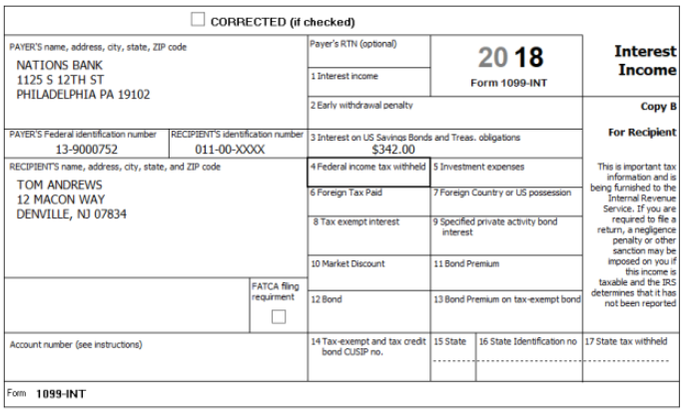
Interest – Form 1099-INT
19
Interest from savings
bonds or US Treasury
obligations
FATCA = Foreign Account
Tax Compliance Act
FATCA is out of scope

Slide 60
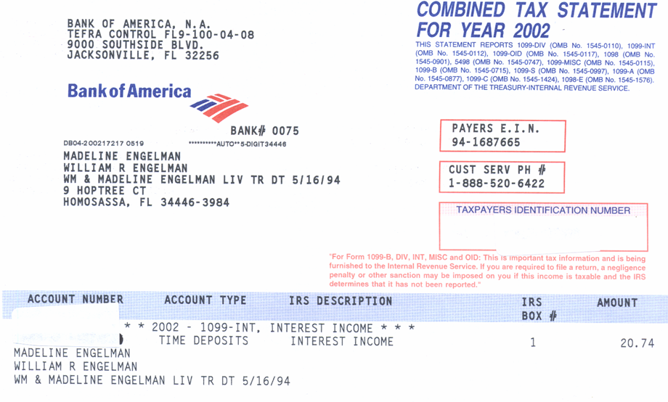
Sample Bank Statement
2019
Douglas Davis
210 Main Street
Bridgewater, NJ 08807
99-2222222
2019
342.00
Notes:
60

Slide 61
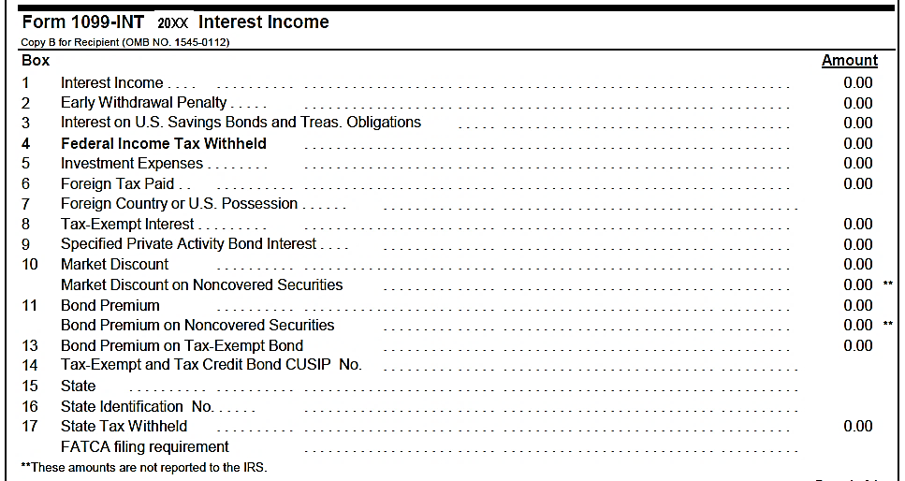
Interest – Sample Brokerage Statement
342.00
FATCA is out of scope

Slide 62
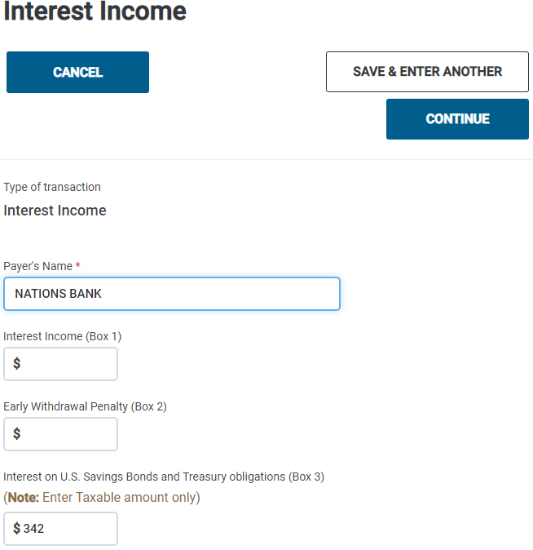
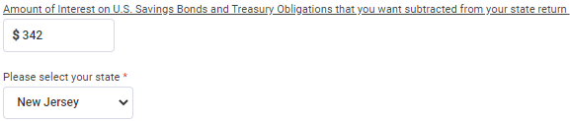
TSO – Entering Interest
Federal Section>Income>1099-DIV, INT, OID> Interest or Dividends Income> Interest Income, Form 1099-INT
Must enter interest from US
obligations twice on TSO
screen
Payer’s name
Interest from savings
bonds or US Treasury
obligations
Interest not taxable
for NJ

Slide 63
TSO - Student Activity
Federal Section>Income>1099-DIV, INT, OID> Interest or Dividends Income> Interest Income, Form 1099-INT
Pause the slide show
Enter the Interest Income into TSO (Step 3)
Check the Federal and NJ refund monitors

Slide 64
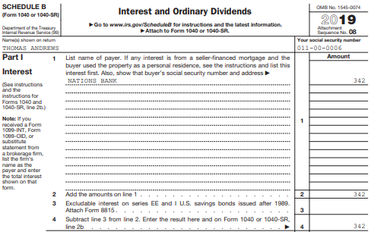
TSO – Taxable Interest on Schedule B
Interest from 1099-INT
Total of all interest

Slide 65
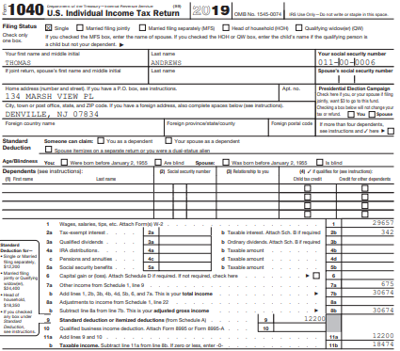
TSO – Taxable Interest on Federal 1040
Transferred from total interest on Schedule B

Slide 66

TSO – Tax-Exempt Interest on NJ 1040
Tax-exempt interest
for NJ

Slide 67
Scenario Step 4
NJ Tax Refund

Slide 68
Recoveries
Return of an amount you deducted or took a credit for in an earlier year
  Most common recoveries are refunds, reimbursements, and rebates of deductions itemized on Schedule A:
    State income tax refund
    Property tax reimbursement (PTR) – covered in later lesson
    Homestead Benefit (HB) – covered in later lesson
    Others – such as medical expense reimbursement
Notes:
68

Slide 69
Recoveries
cont’d
Tax benefit rule
  Must include a recovery in your income in the year you receive it up to the amount by which the deduction/ credit you took for the recovered amount reduced your tax in earlier year
Use NJ Tax Refund Worksheet on TP4F Preparer page to determine how much of recovery has to be claimed in current year
Notes:
69

Slide 70
Be Sure to Verify the Amount of the NJ Income Tax Refund
Amount of previous year NJ income tax refund must be verified
  Amount could have changed from what is shown on prior year return (error found, return amended, etc.)
Can get info on NJ income tax refund from NJ Division of Taxation website Refund Lookup Tool
  Link from TP4F Preparer page to NJ Form 1099-G Inquiry
  Need SS # and Date of Birth
Notes:
70

Slide 71
Did Andrews Receive a Tax Benefit in Prior Year By Claiming NJ Income Taxes Paid?
Determine if there was a tax benefit in earlier year from NJ income tax paid
No tax benefit in earlier year if:
  Taxpayer did not itemize (claimed standard deduction) OR
  Elected to deduct State & Local sales tax instead of State & Local Income tax
If no tax benefit in earlier year, don’t declare refund in current year
Andrews took standard deduction in prior year, so no recovery to declare in current year
  No TSO entry required

Slide 72
NJ Income Tax Refund on NJ Return
NJ income tax refund is not taxable on NJ return
  TSO handles automatically
  No entry needed on NJ Checklist

Slide 73
TSO - Student Activity
Pause the slide show
Determine whether Andrews’ NJ income tax refund from prior year is taxable as income on this year’s Federal return
  Why or why not?

Slide 74
TSO - Student Activity
cont’d
  Answer: Andrews claimed the standard deduction last year, so no tax benefit from claiming state income taxes on Schedule A. Therefore, no need to claim refund as income this year
NJ income tax refunds are never taxable for NJ, so there is no change on the NJ return
Since no entries into TSO were made in this step, the Federal and NJ refund monitors have not changed

Slide 75
Adjustments to Income
Tom Andrews

Slide 76
Adjusted Gross Income
Total Income
minus Adjustments
=
Adjusted Gross Income (AGI)
Notes:
76

Slide 77
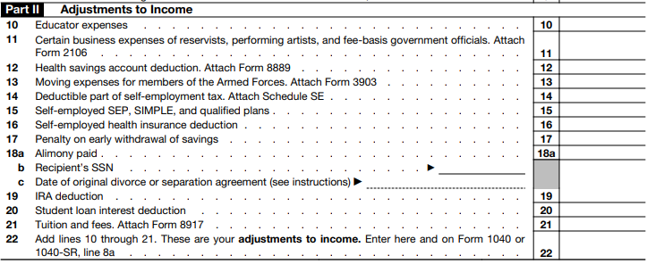
Adjustments to Income on Schedule 1, Part II
This lesson will deal with Student Loan Interest and IRA Deduction *
* These adjustments do not impact the NJ return
Notes:
77

Slide 78
Scenario Step 5
Student Loan Interest – Peoples Federal Bank

Slide 79
Student Loan Interest
Interest paid on qualified student loan for post secondary education expenses
Qualified loan:
  Loan money is used for expenses of taxpayer, spouse, or dependent (dependent when loan originated)
  For education provided when student enrolled at least ½ time in degree program
  Taxpayer must be legally liable for the loan

Slide 80
Student Loan Interest
cont’d
Qualified loan
  Loan cannot be from relative
  Taxpayer cannot file MFS
  Taxpayer (or spouse) cannot be claimed on someone else’s return
  Loan cannot be from qualified retirement plan
  Loan cannot be through an employer-provided educational assistance program

Slide 81
Student Loan Interest – Limitations
Limitations:
  Maximum $2,500 per year
  Phases out as AGI increases
    TSO calculates automatically
If interest >$600, taxpayer should receive Form 1098-E
Refer to Pub 4012 Page E-10 for more info

Slide 82
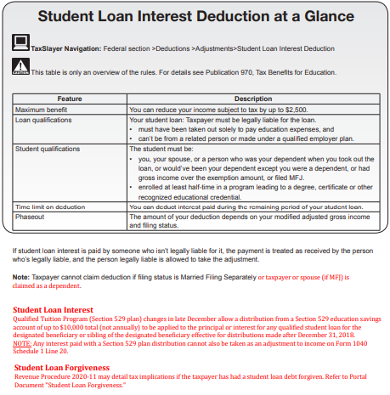
Student Loan Interest – Pub 4012 Page E-10

Slide 83
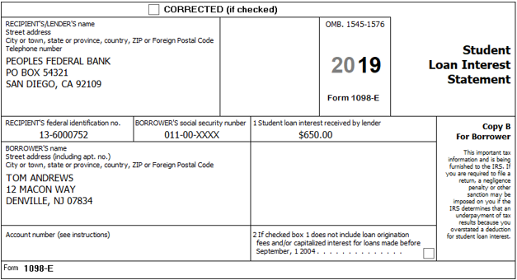
Form 1098-E Student Loan Interest Statement
Student loan interest

Slide 84
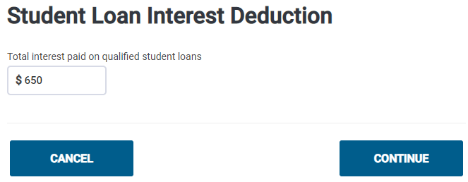
TSO – Entering Student Loan Interest
Federal Section>Deductions>Adjustments>Student Loan Interest Deduction
Student loan interest

Slide 85
TSO - Student Activity
Federal Section>Deductions>Adjustments>Student Loan Interest Deduction
Pause the slide show
Enter the Student Loan Deduction into TSO (Step 5)
Check the Federal and NJ refund monitors

Slide 86
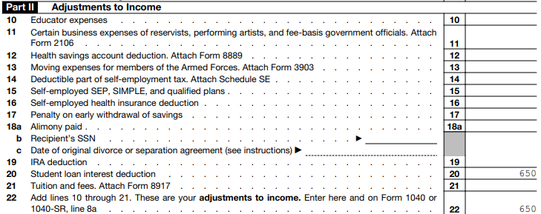
TSO – Student Loan Interest on Schedule 1, Part II
Transferred from
Student Loan Interest
screen
Total of all Adjust-
ments to Income

Slide 87
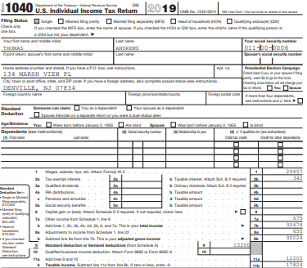
TSO – Adjustments on Federal 1040
Transferred from Sch 1,
Part II, total

Slide 88
Scenario Step 6
Traditional IRA Contribution Adjustment To Income

Slide 89
IRAs – Individual Retirement Accounts
Different types of IRAs
  Traditional IRA
    IRA with deductible contributions
    IRA with nondeductible contributions
  Roth IRA
  SEP IRA (Simplified Employee Pension) – employer-sponsored retirement plan only employers can contribute to
  Simple IRA (Savings Incentive Match Plans for Employees) - employer-sponsored retirement plan that both employers and employees can contribute to
SEP IRA contributions
are Out of Scope
Simple IRA contributions
are Out of Scope
Notes:
89

Slide 90
Traditional IRA Contribution Rules
Taxpayer has until the April due date of the return to make an IRA contribution for the current tax year and still include it on this year’s return
  Extended to July 15, 2020, for 2019 contributions due to pandemic
  Ask taxpayer what year contribution is for
Age limits for contributions
  For years prior to 2020, under 70½ as of the end of the year
  Beginning in 2020 tax year, no age limit as long as you have earned income

Slide 91
Traditional IRA Contribution Rules
cont’d
Contribution limit
  $6,000 ($7,000 if age 50 or over)
  If more than one IRA, allowable contribution amount applies to all IRAs (including Roth IRAs)
However, allowable contribution cannot be more than taxable compensation
  For IRA deduction, taxable income includes W-2 income, self-employment income, and taxable alimony
  Does NOT include interest, dividends, pensions, scholarships, unemployment, Social Security

Slide 92
Traditional IRA Deduction – Deductible and Non-Deductible Contributions
cont’d
Usually can claim a deduction for amount of traditional IRA contribution, up to the maximum limit
  If taxpayer participates in an employer’s retirement plan and/or AGI is too high, some or all of traditional IRA contribution may be nondeductible
  TSO calculate allowable deduction
Allowable contribution in excess of deduction becomes cost basis in the IRA (Form 8606)
  Becomes important in calculating taxable amount when money is withdrawn from the IRA
  TSO prepares Form 8606 automatically if there is a nondeductible contribution
Earnings accumulate tax deferred until withdrawn from IRA

Slide 93
Traditional IRA Contribution – Excess Contributions
If there is an excess contribution (over allowable limit)
  Have until due date of the return to withdraw excess amount
  Otherwise, subject to 6% penalty each year until remedied
    Out of Scope

Slide 94
Traditional IRA – Required Minimum Distributions (RMDs)
For years before 2020, taxpayer had to withdraw a Required Minimum Distribution (RMD) starting by April 1 of year after calendar year they turned 70½ and every year after
  Trustee tells you amount of RMD
  Amount of RMD not withdrawn is subject to 50% penalty
  Income tax is paid on money withdrawn
  If first RMD is taken in January-March of year after taxpayer reached 70½ , two RMDs will have to be taken that year
Beginning in 2020, RMDs must start at age 72
  RMD waived in 2020 due to pandemic

Slide 95
Traditional IRA Contribution on NJ Return
NJ does not allow a deduction for an IRA contribution; contribution is considered after-tax money
  TSO handles this automatically
  No entry on NJ Checklist is needed
If taxpayer keeps a record of these NJ after-tax contributions, they will not have to pay tax on the money contributed when distributions are taken from the IRA
  Only earnings would be taxed upon distribution
  IRA Worksheet on TP4F Preparer page would be used to calculate taxable amount
  Counselor should suggest to taxpayer that they keep good records

Slide 96
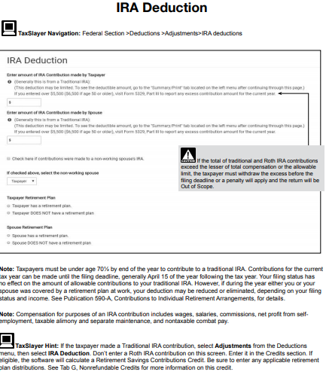
Traditional IRA Deduction – Pub 4012 Page E-9

Slide 97
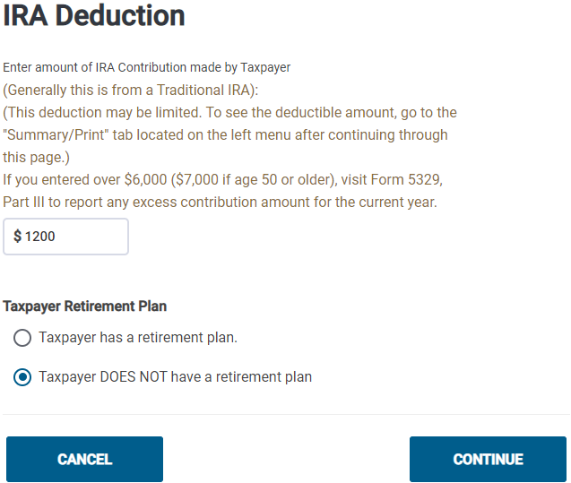
TSO – Entering Traditional IRA Deduction
Federal Section>Deductions>Adjustments>IRA Deduction
Traditional IRA contribution

Slide 98
TSO - Student Activity
Federal Section>Deductions>Adjustments>IRA Deduction
Pause the slide show
Enter the Traditional IRA Contribution Adjustment into TSO (Step 6)
Check the Federal refund monitor
NJ refund monitor does not change since NJ does not allow a deduction for traditional IRA contributions
  After-tax money for NJ

Slide 99
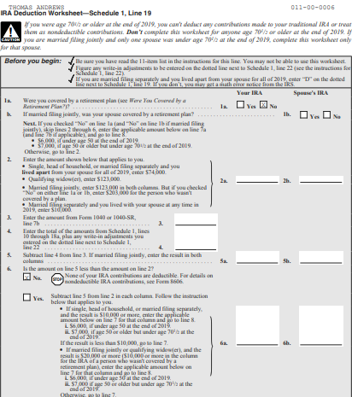
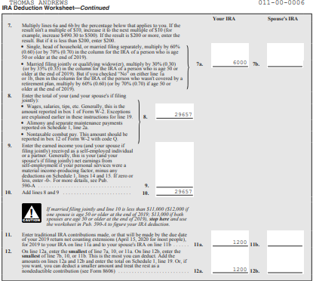
TSO - IRA Worksheet
TSO prepares an IRA Worksheet to show IRA contribution and how much is deductible (in printed return PDF)
IRA contribution amount
IRA deduction amount

Slide 100
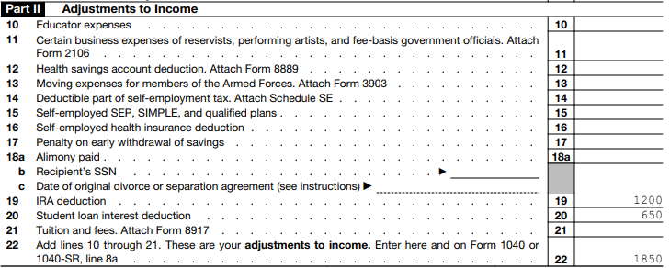
TSO – Traditional IRA Deduction on Schedule 1, Part II
Transferred from IRA Deduction screen
Total of all Adjust-
ments to Income
Notes:
100

Slide 101
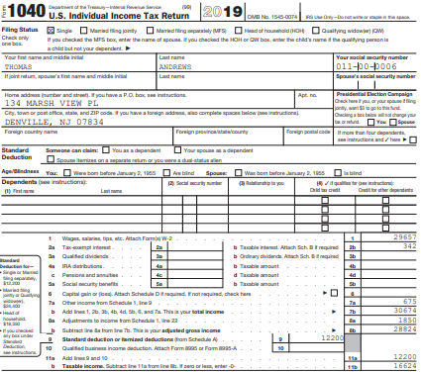
TSO – Adjustments on Federal 1040
Transferred from Schedule 1,
Part II, total adjustments
(includes Student Loan
Interest and IRA Deduction)
Notes:
101

Slide 102
Scenario Step 7
Roth IRA Contribution

Slide 103
Roth IRA Contributions
Can contribute to Roth IRA in two ways:
After-tax contributions (no deduction allowed)
  No age limit for contributions, but must have earned income
  Dollar limits on contributions same as for Traditional IRA ($6,000/$7,000 if age 50 or older)
Money converted from a Traditional to Roth IRA
  No income limits for who can convert
  Pay income tax when contribution is converted
Notes:
103

Slide 104
Roth IRA Contributions
Taxpayer has until the April due date of the return to make a Roth IRA contribution for the current tax year and still include it on this year’s return
  Same as Traditional IRA
  Ask taxpayer what year contribution is for
  2019 contribution deadline extended to July 15, 2020 due to pandemic

Slide 105
Roth IRA Rules
Contributions are after-tax
Earnings accumulate tax free (not just tax deferred like Traditional IRA)
Distributions are generally not taxable (neither contributions nor earnings)
  Exception: Distribution within 5-yr qualifying period from date Roth IRA was first established may be subject to tax on earnings plus 10% early distribution penalty
No Required Minimum Distribution (RMD)
  Amounts withdrawn from Roth IRA cannot be used to satisfy RMD for Traditional IRA
Rules for taxability of Roth distributions are the same for NJ as for Federal
Notes:
105
Explain that “tax free” means never having to pay tax; “tax deferred” means you can put off paying the tax, but you must pay tax in the future

Slide 106
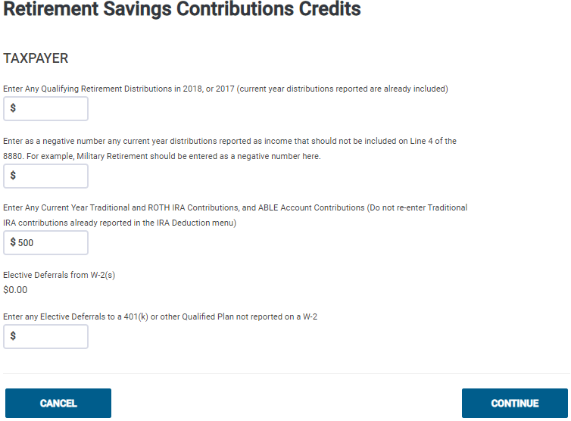
TSO – Entering Roth IRA Contribution
Federal Section>Deductions>Credits>Retirement Savings Credit
No deduction for Roth
IRA contribution, but
enter Into TSO;
May qualify for a Retire-
ment Savings Credit

Slide 107
TSO - Student Activity
Federal Section>Deductions>Credits>Retirement Savings Credit
Pause the slide show
Enter the Roth IRA Contribution into TSO (Step 7)
Check the Federal and NJ refund monitors
  Federal refund monitor increased because the retirement savings credit went up due to the Roth IRA contribution
  NJ refund monitor did not change because this credit does not impact the NJ return

Slide 108
Deductions
Tom Andrews

Slide 109
Deductions
Deductions are subtractions from a taxpayer’s adjusted gross income (AGI)
Reduces amount of income tax to pay
Most taxpayers have a choice between:
  Claiming standard deduction
  Itemizing deductions
TSO automatically determines whether standard deduction or itemizing results in lower tax

Slide 110
Standard Deduction
Amount of standard deduction is based on:
  Filing status
  Age (65 or older)
  Blindness
If taxpayer can be claimed as a dependent on another taxpayer’s return, then standard deduction may be limited
Standard deduction amount subject to change each year
Refer to Pub 4012 Pages F-1 and F-2 to examine possibilities for a single working taxpayer
110

Slide 111
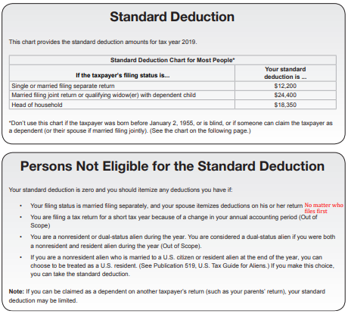
Standard Deduction – Pub 4012 Page F-1
Standard Deduction for most people
Certain persons not eligible for standard
deduction
111

Slide 112
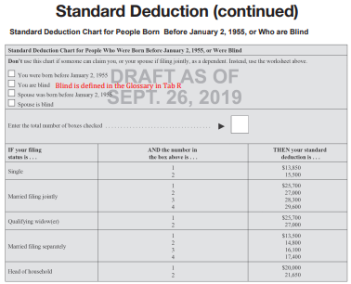
Standard Deduction – Pub 4012 Page F-2
Extra standard deduction for:
Age 65 or older
Blind
112

Slide 113
Itemized Deductions
Refer to Pub 4012 Pages F-3 through F-5 to see possible itemized deductions
  Discuss possible deductions with taxpayer to ballpark total amount
If it is obvious that standard deduction would be higher, no need to enter most itemized deductions
  Andrews will use standard deduction
  No need to enter charitable donations for Andrews on 2019 return
    Tax law has changed for 2020, so this may change (will be covered in What’s New for 2020)
Always enter medical deductions, even if not itemizing, because medical expenses can be helpful on NJ return
113

Slide 114
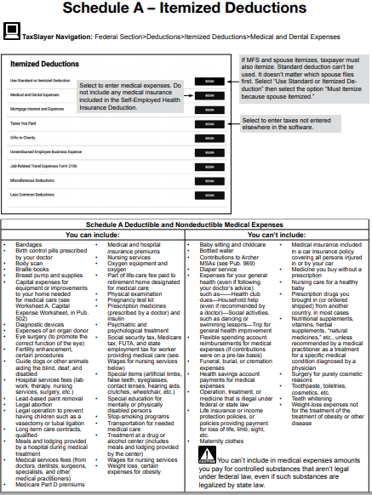
Itemized Deductions – Pub 4012 Page F-5
114

Slide 115
Scenario Step 8
Itemized Deductions Schedule A - Medical

Slide 116
Itemized Deductions – Medical Expenses
Can claim amount of unreimbursed medical expenses which exceeds 7.5% of AGI
  Enter allowable medical expenses, and TSO does the calculation
Refer to Pub 4012 Page F-5 to see allowable medical expenses
NJ allows you to claim amount of unreimbursed medical expenses which exceeds 2% of NJ gross income
  TSO automatically calculates
116

Slide 117
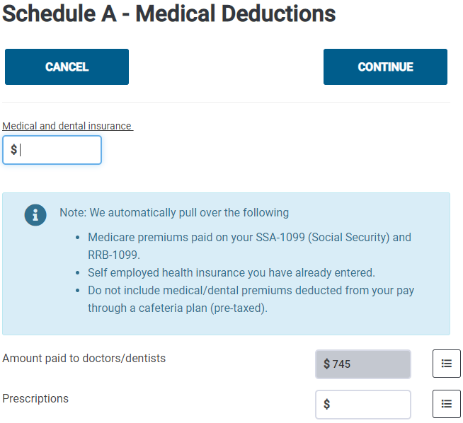
TSO – Entering Medical Expenses
Federal Section>Deductions>Itemized Deductions>Medical & Dental Expenses
To document details of
medical expenses (see
next slide)
117
TSO adds up detail amounts and populates total

Slide 118
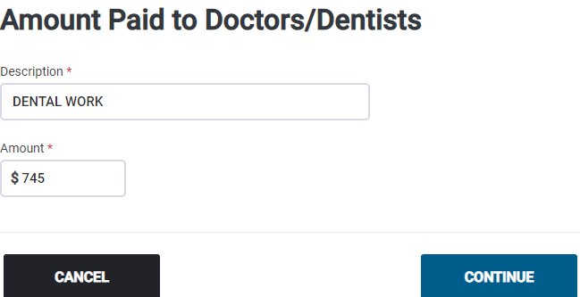
TSO – Entering Details of Medical Expenses
Details of medical expenses
118

Slide 119
TSO - Student Activity
Federal Section>Deductions>Itemized Deductions>Medical & Dental Expenses
Pause the slide show
Enter the Medical Expenses into TSO (Step 8)
  No need to enter the charitable donations
Check the Federal and NJ refund monitors

Slide 120
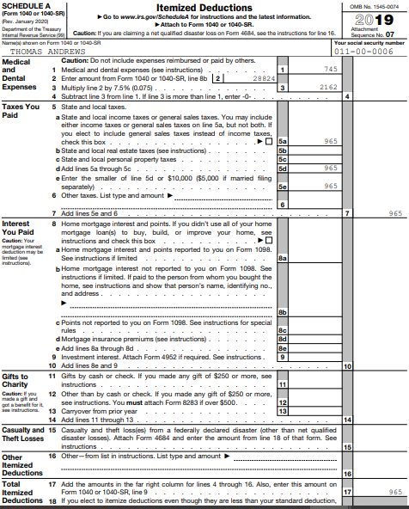
TSO – Schedule A
TSO calculates deductible
amount of medical expenses
(over 7.5% of AGI) and
populates on Schedule A
TSO transfers state taxes from W-2
120

Slide 121

TSO – NJ 1040
TSO calculates amount
of NJ deductible medical
expenses (over 2% of
NJ Gross Income) and
populates on NJ 1040
121

Slide 122

TSO – Comparing Standard vs. Itemized Deductions
Federal Section>Deductions>Compare Deductions
122

Slide 123
Credits
Tom Andrews

Slide 124
Credits
Credits reduce tax amount due dollar for dollar
  Different from deductions which reduce taxable income
Non-refundable vs. refundable credits
  Non-refundable - can reduce the tax liability to zero, but does not provide a refund beyond amount of taxes owed
  Refundable - can reduce the tax liability to zero and provide a refund of excess credit beyond what is owed

Slide 125
Scenario Step 9
Retirement Savings Credit Form 8880

Slide 126
Retirement Savings Credit
Nonrefundable credit for contributing to a retirement plan such as an IRA, 401k, 403b, 457b, etc.
Amount of credit is based on AGI & filing status
TaxSlayer automatically generates Form 8880 to calculate this credit if:
  Traditional or Roth IRA contribution is entered OR
  Form W-2 indicates a retirement contribution in Box 12 or 14
Notes:
126

Slide 127
How Do You Know if Retirement Savings Contributions Were Made?
Ask if taxpayer made contribution to a retirement account
  E.g. – Traditional or Roth IRA contribution
Check tax documents
  Boxes 12 and 14 on W-2 (see next slide)
Check question on Intake/Interview sheet

Slide 128
W-2 Codes that Indicate Retirements Savings
Contributions
Following codes in Box 12 will generate Form 8880 automatically: D, E, F, G, H, S, AA, BB
Certain entries in Box 14 require taxpayer interview to see if entry qualifies for Form 8880
  To qualify, contribution must be a VOLUNTARY contribution
  Most common entry we see is 414h pension
    414h pension is designated as an employee contribution, but employer picks up the contribution; therefore, not considered voluntary contribution made by employee and doesn’t qualify for Retirement Savings Credit

Slide 129

W-2 Box 14 Retirement Savings Contributions
For voluntary contributions, choose this code from drop-down menu
For mandatory contributions, choose this code
Do NOT choose this code

Slide 130

Retirement Savings Credit Eligibility Requirements and Reminders – Pub 4012 Page G-14
Further info on Pub 4012
Pages G-14 through G-16
Notes:
130

Slide 131
Retirements Savings Contributions Credit Calculations
Certain distributions received in prior 2 tax years, current tax year, and before due date of return must be subtracted from contributions before TSO calculates credit
  Current tax year distributions already entered in TSO (on 1099-R screen) are automatically subtracted
  Amounts of distributions from 2 prior years or between 1/1 and filing deadline must be entered manually on Form 8880 screen so that TSO knows how much to subtract

Slide 132

Retirements Savings Contributions Credit Calculations
cont’d
Certain 1099-Rs can be excluded as distributions for this credit (see list on Pub 4012 Page G-16)
  In order to exclude, check box on 1099-R screen “Does not carry to Form 8880”

Slide 133

TSO – Entering Info on Form 8880 Screen
Federal Section>Deductions>Credits Menu>Retirement Saving Credit
Add in distributions from 2 prior years
DO NOT USE; instead check “Does not carry to Form 8880”
box on 1099-R screen
Roth IRA contributions; do not re-enter Traditional IRA from IRA
Deduction screen
W-2 amounts automatically transferred
Notes:
133

Slide 134
TSO - Student Activity
You have already entered the only required entry on Form 8880 for Tom’s Roth IRA contribution. Therefore, nothing to do in this step 9
The Federal and NJ refund monitors stay the same as the prior step since no TSO entries were made here

Slide 135

TSO – Form 8880 – Retirement Savings Contribu-tions Credit
Traditional + Roth IRA
contributions
Retirement Savings
Contributions credit
Notes:
135

Slide 136

TSO – Retirement Savings Contributions Credit on Schedule 3, Part I
Transferred from Form 8880
Total of all Nonrefundable
Credits
Notes:
136

Slide 137

TSO – Federal 1040, Page 2
Tranferred from Sch 3,
Part 1, total
Notes:
137

Slide 138
Federal Health Insurance
Tom Andrews

Slide 139
Scenario Step 10
Health Insurance (Federal)

Slide 140
Federal Health Insurance
On Federal return, there is no longer a Shared Responsibility Payment (penalty) if taxpayer does not have health insurance
Only entry required on Federal return is to state if taxpayer purchased health insurance through the Marketplace
  If taxpayer did purchase insurance through the Marketplace and received an Advance Premium Tax Credit to help pay premiums, a reconciliation of amount received must be done (covered in later lesson)

Slide 141

TSO – Entering Federal Health Insurance Info
Health Insurance section

Slide 142
TSO - Student Activity
Health Insurance section
Pause the slide show
Complete TSO Health Insurance section by stating that Andrews did not purchase insurance through the Marketplace (Step 10)
Check that Federal and NJ refund monitors did not change from prior step

Slide 143
State Section
Tom Andrews

Slide 144
TSO – Enter NJ Items from NJ Checklist
Enter items documented on the NJ Checklist into TSO State Section
  Appropriate submenus are indicated in black lines on NJ Checklist
  Enter documented item on line indicated in right-hand column of NJ Checklist

Slide 145

NJ Checklist
State Section
Sub-Menu
Line on screen
to enter item

Slide 146
Scenario Step 11
NJ Return

Slide 147
Scenario Step 11a
NJ Property Tax Credit Or Deduction

Slide 148
NJ Property Tax Credit or Deduction
NJ has several property tax relief programs
  More details about these programs in Davenport problem
  Refer to NJ Special Handling document on TP4F Preparer page
One of the programs is a property tax credit or deduction on NJ 1040 for NJ residents who are homeowners or renters
Can claim credit or deduction, whichever is better
  Enter property tax info, and TSO determines which is better
Credit is claimed on NJ 1040 Line 55
  Credit is $50 ($25 if taxpayer and spouse file separate returns but maintain the same principal residence)

Slide 149
NJ Property Tax Credit or Deduction
cont’d
Deduction is claimed on NJ 1040 Line 39
  Maximum allowable deduction is $15,000
Tenants can claim 18% of rent paid as property taxes
Note property tax amount on NJ Checklist in Credits section

Slide 150
General Eligibility Requirements for NJ Property Tax Credit/Deduction
Domiciled and maintained a principal residence as a homeowner or tenant in NJ
  Must live in residence; cannot rent it out
Principal residence was subject to property taxes that were paid as actual property taxes or through rent
  Cannot claim if living in tax-exempt housing not subject to property taxes or in housing subject to Payments in Lieu of Taxes - P.I.L.O.T.
Gross income (NJ 1040 Line 29) > $20K for MFJ/HOH/QW or $10K for S/MFS)
  OR
Age 65 & older or blind or disabled

Slide 151
Renters - Specific Eligibility Requirements for NJ Property Tax Credit
Legally responsible for paying rent & rent has been paid
  Written agreement with landlord or person on lease stating responsibility
  If taxpayer lives with someone & contributes towards rent, but no written document stating responsibility, cannot claim property tax credit. Responsible party can claim
Rented dwelling must have separate kitchen & bath facilities
Residence must be subject to property taxes (not public housing, dorms, special construction tax breaks)

Slide 152
Use of Scratch Pads to Calculate and Document
Scratch pads available on TP4F Preparer page
When a calculation is necessary, use scratch pads to document for quality reviewer and taxpayer records
Available scratch pads (in drop-down menu):
  Medicare premiums
  Schedule A property taxes
  NJ property taxes and/or rent
  NJ gambling
  Blank – for other miscellaneous calculations

Slide 153

Scratch Pad for Andrews Rent
Total property tax
that can be claimed
Use formula to calculate
18% of yearly rent

Slide 154

Enter Property Tax Information on NJ Checklist
18% of rent

Slide 155

TSO – Entering Property Tax Credit/Deduction
State Section>NJ>Credits>Property Tax Credit/Deduction
Refer to NJ Special Handling document for requirements
18% of rent paid
Renter

Slide 156
TSO - Student Activity
State Section>NJ>Credits>Property Tax Credit/Deduction
Pause the slide show
Enter the Property Tax information from the NJ Checklist Credits section into TSO State Section (Step 11A)

Slide 157
Scenario Step 11b
NJ Health Insurance

Slide 158

Enter NJ Health Insurance Information on NJ Checklist
Based on interview, indicate on NJ Checklist that Andrews had health insurance all year

Slide 159

TSO – Entering NJ Health Care Coverage
State Section>Tax>Health Care Coverage (Sch NJ-HCC)
NJ Health Mandate will be covered in
more detail in a separate module
NJ health insurance status

Slide 160
Student Activity
Pause the slide show
Enter the NJ Health Insurance Information into TSO State Section (Step 11B)

Slide 161
Scenario Step 11c
NJ Basic Information

Slide 162
NJ State Basic Information – Military Veterans
A U.S. military veteran is eligible for a $6,000 exemption on the NJ return
  Honorably discharged or released under honorable circumstances from active duty any time before the last day of the tax year
  Taxpayer and spouse both get exemption if both are eligible veterans ($12,000)
  Qualifying veterans only (not surviving spouses)
Must provide official discharge documentation along with an application form to the State Treasury the first year this exemption is claimed

Slide 163

TSO – Entering NJ Basic Information Section
State Section>NJ>Basic Information
County/Municipality of current residence

Slide 164

TSO – NJ Basic Information Section
cont’d
Gubernatorial Elections Fund
Veteran deduction

Slide 165
TSO - Student Activity
State Section>NJ>Basic Information
Pause the slide show
Enter the items from the NJ Checklist Basic Information section into TSO State Section (Step 11C)
  Must click Save a few times and then Exit New Jersey Return before TSO will update NJ refund monitor
Check the Federal and NJ refund monitors

Slide 166

TSO – NJ 1040
Veterans exemption
$6000

Slide 167

TSO – Property Tax Credit on NJ 1040
NJ property tax credit

Slide 168
Scenario Step 12
E-file Section

Slide 169
TSO – Completing Andrews E-File Section
Complete these steps in Andrews E-file section:
  Federal return type – choose type based on Andrews’ choice on Intake/Interview sheet (Additional Information section, question 3)
    E-file: Paper Check
    E-file: Direct Deposit
    Paper Return with Direct Deposit
    Paper Return
  State return type
    Same as Federal choices (but in different order)
Follow district rules for completing other sections of E-file section

Slide 170

TSO – Federal Return Type
E-file Section>Return Type
Choose E-file: Paper Check from drop-down menu

Slide 171

TSO – State Return Type
E-file Section>State Return(s)
Choose E-file: Paper Check
from drop-down menu

Slide 172
Final Steps
After all information is entered into TSO, the following steps still need to be done. They are not simulated in this practice return:
  A quality reviewer must check everything on the Intake/Interview sheet and on the Federal and NJ returns in TSO
  The PDF of the Federal and NJ returns must be printed for the taxpayer’s records
  The counselor must review both returns with taxpayers to ensure that they understand everything
  The taxpayer(s) must sign Form 8879 from the PDF
    Gives permission for e-filing
    Acknowledges that taxpayer(s) is responsible for the accuracy of the info on return

Slide 173
Final Steps
  Return must be marked ready for e-file
    ERO will perform the actual e-filing
    If e-file is rejected by IRS or NJ, corrections must be made as necessary
  Tax envelope must be assembled for taxpayer(s), including:
    All source documents (tax forms, taxpayer lists, etc.)
    Intake/Interview sheet
    NJ Checklist
    Scratch pads and printed results from TP4F tax tools
    Printed Federal and NJ returns
    Form 8879
    No taxpayer information or papers are kept by the counselor

